Slide 1
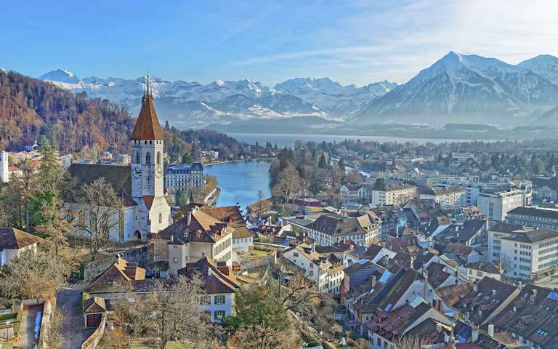
Rhineland
Pim Huisman – Concept / Environment Art
Scott Vetketel – Environment Art
Jens Walgien – Character Art
Jorrit Kornelis – Producer
Daniël Stremmelaar – Programmer / Game Design

Slide 2
Inhoud
Changes
Reflection
Art Progression
Plans
Prototype

Slide 3
Changes
Resources
Upgrade system
Supply chain

Slide 4
Reflection
Ups
Overleg
Motivatie
Design
Downs
Tempo

Slide 5
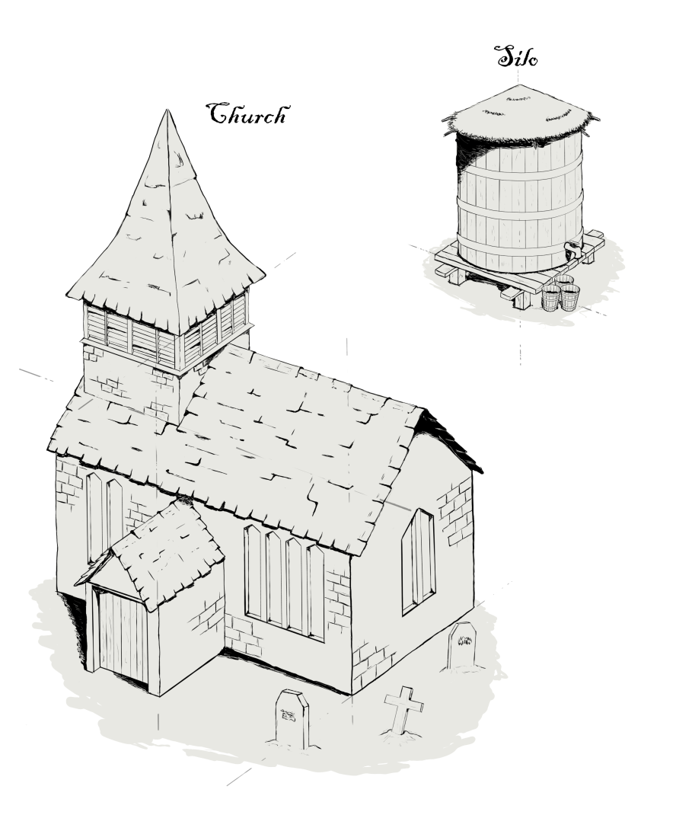
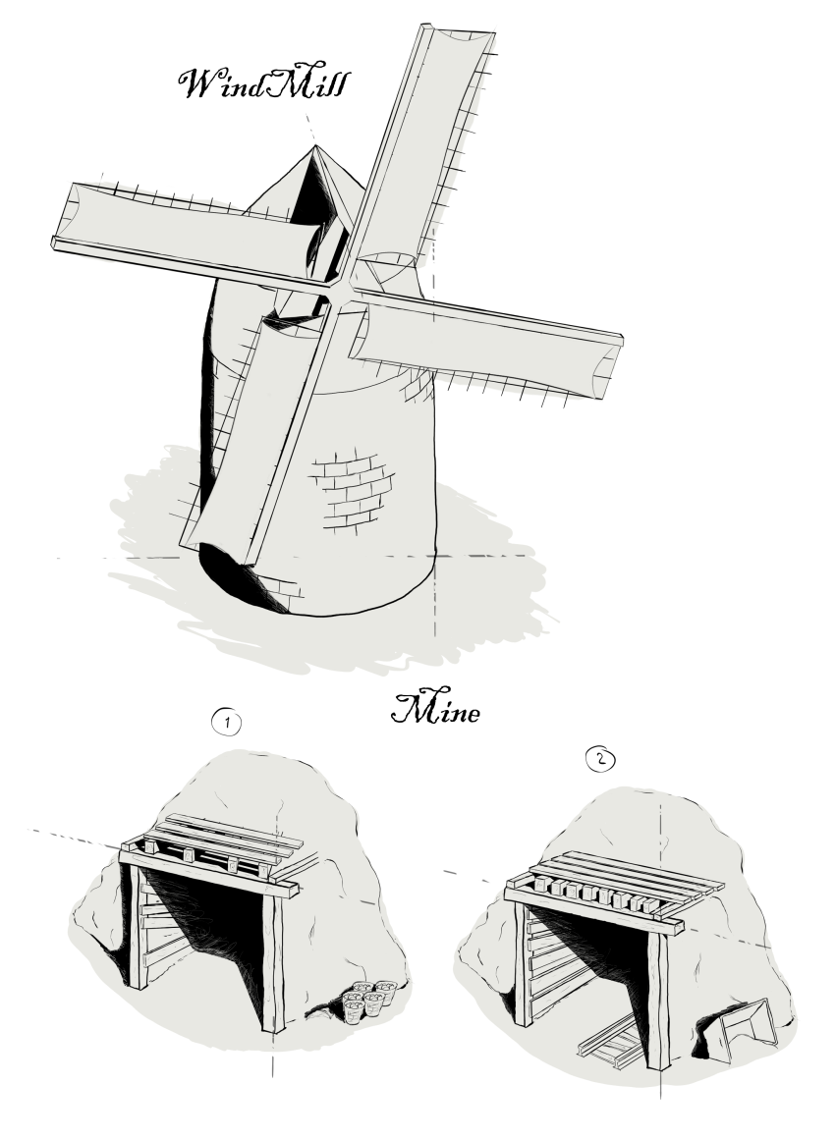
Art Progression

Slide 6
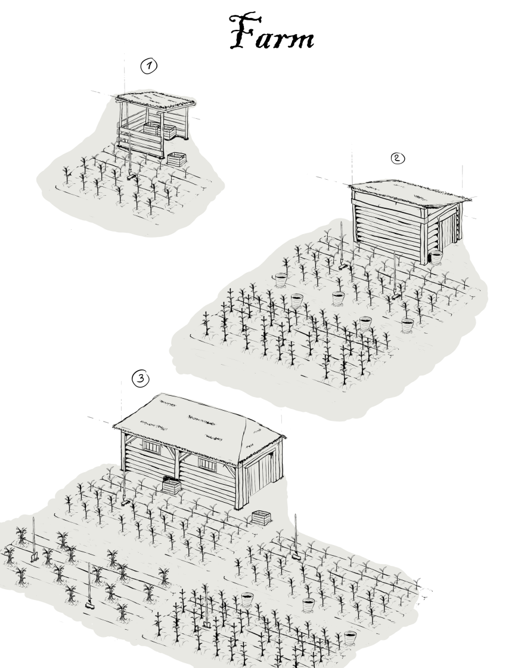
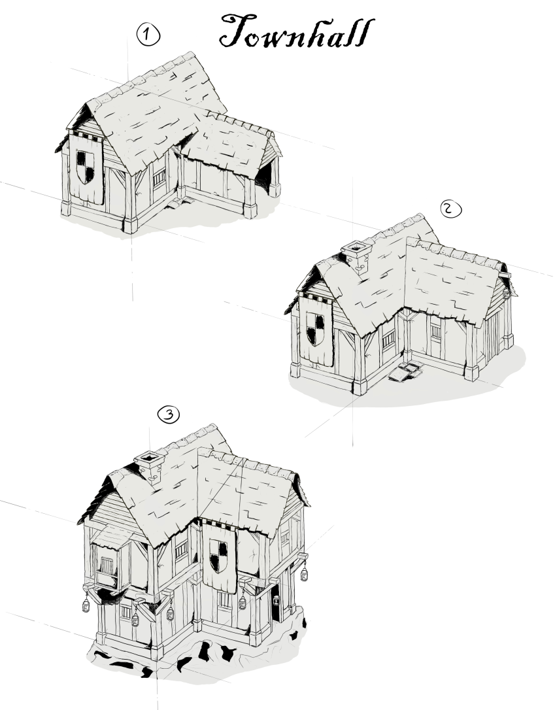
Art Progression

Slide 7
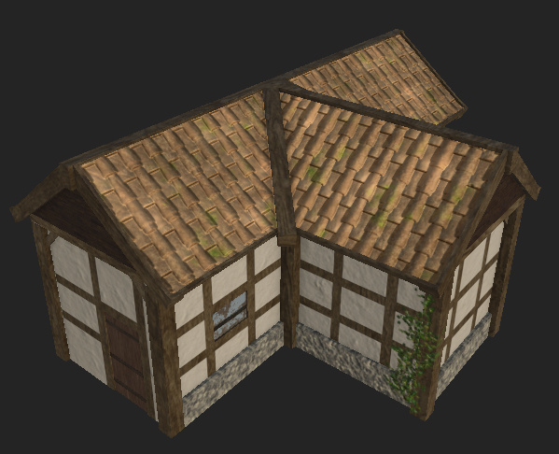
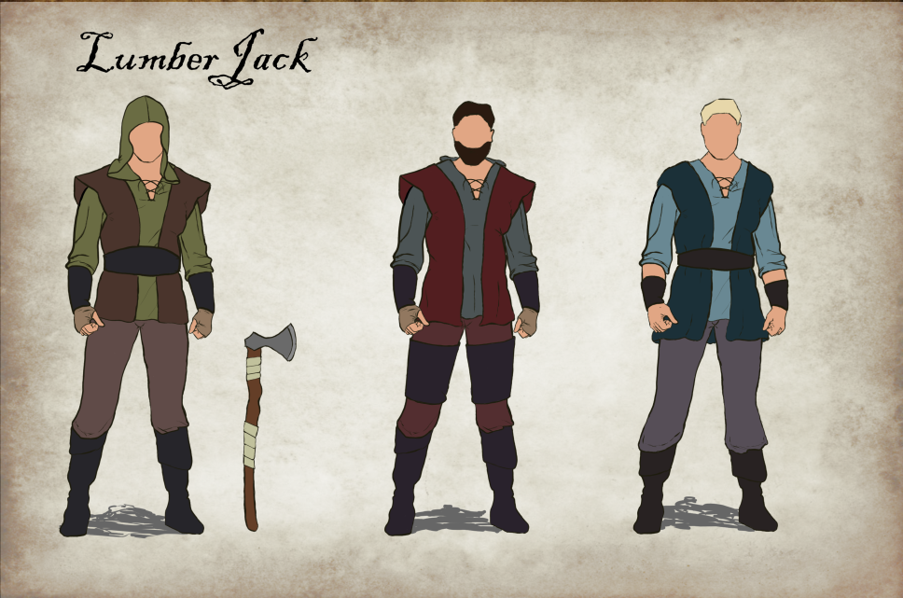
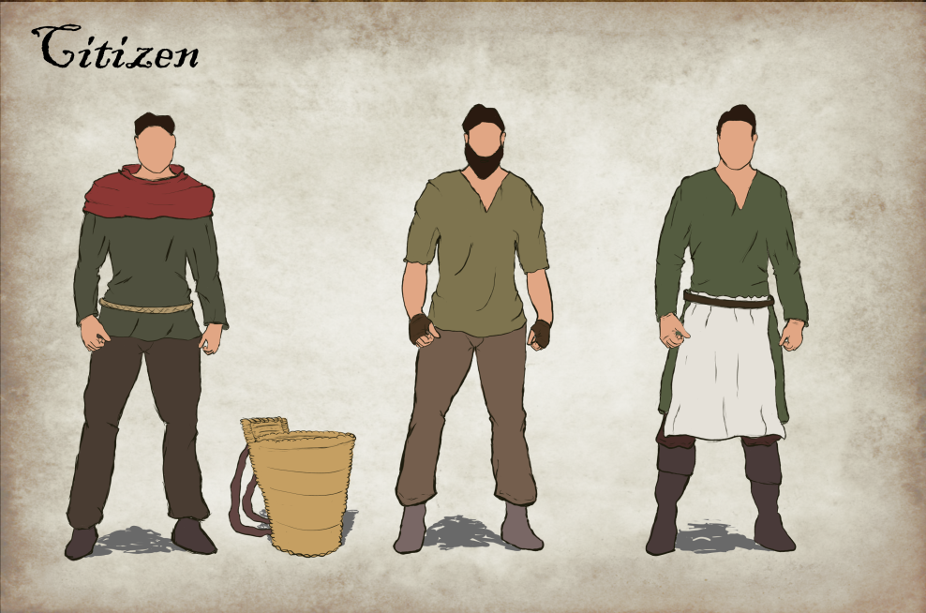
Art Progression

Slide 8
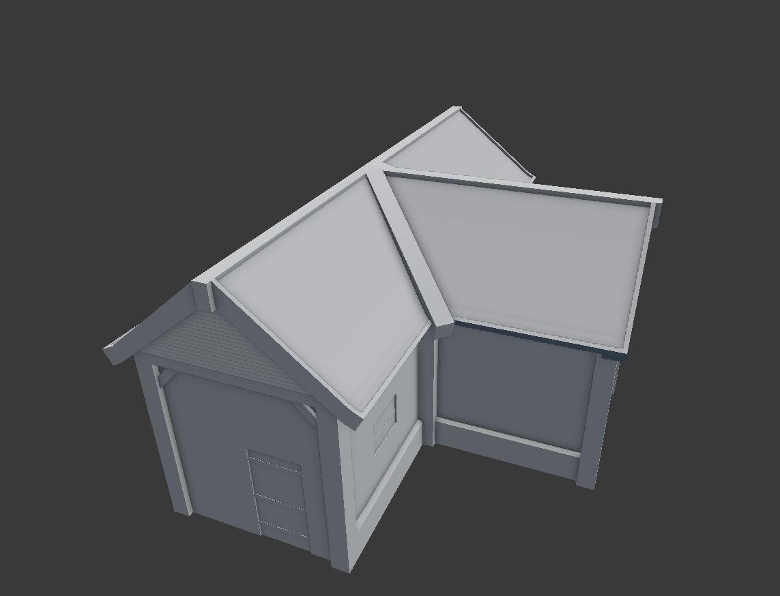
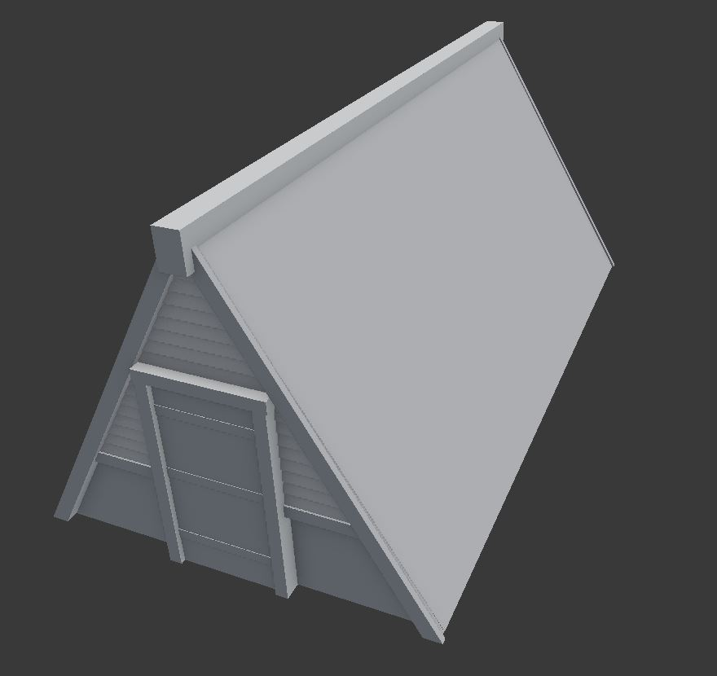
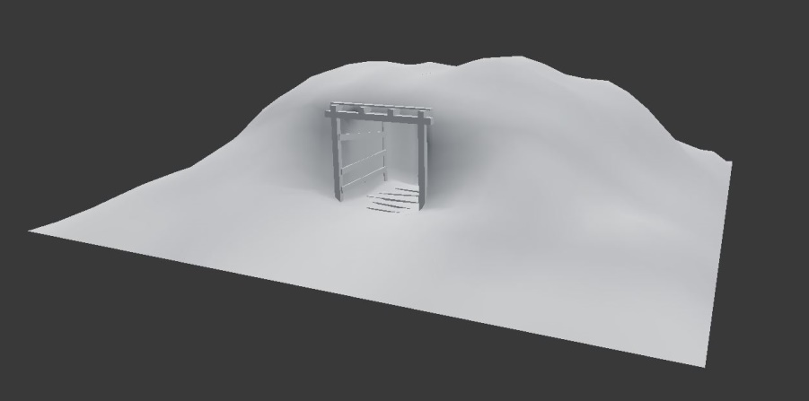
Art Progression

Slide 9
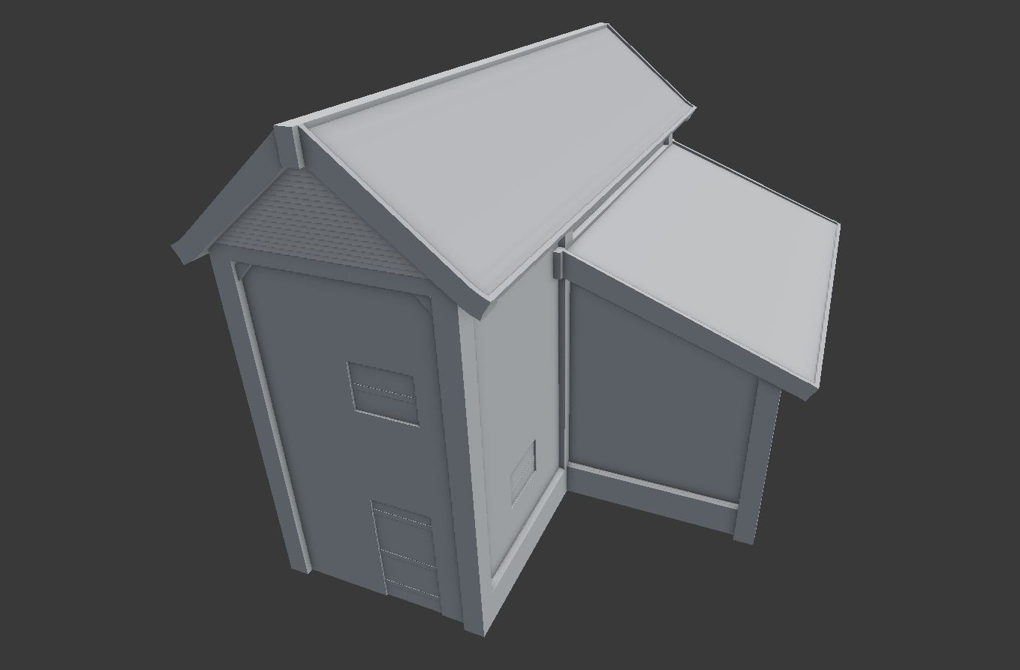
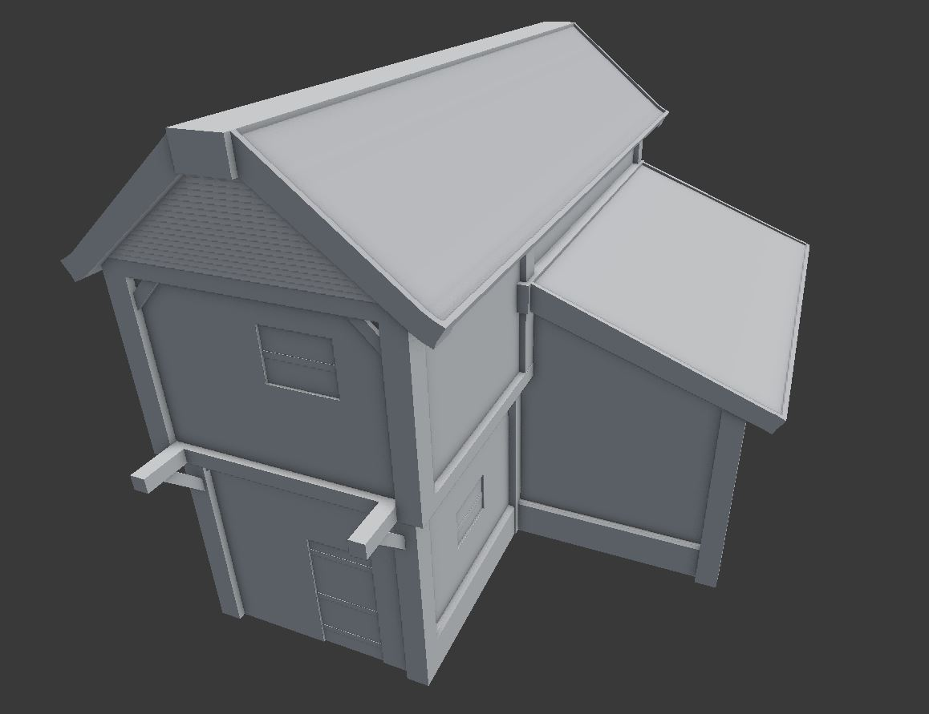
Art Progression

Slide 10
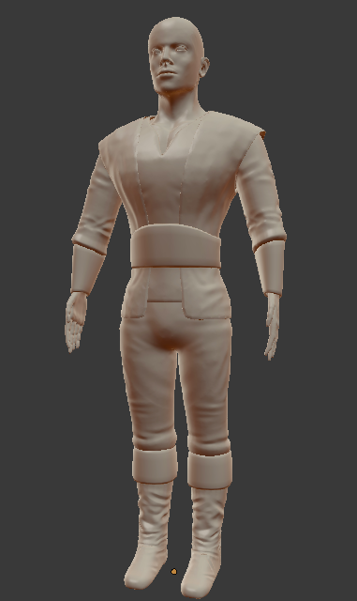
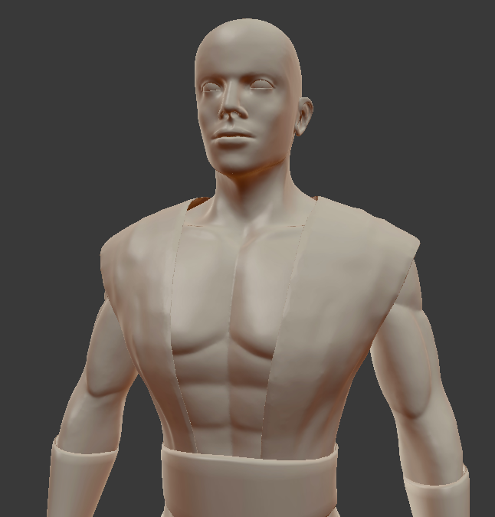
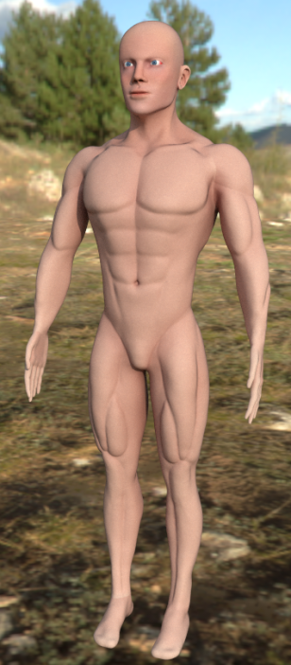
Art Progression

Slide 11
Plans
Happiness
Starvation
Random map
Spawn selection

Slide 12
Prototype

